Slide 1


IGNIS GUARD
Design and Development of a Simulation-Based Game Application for Fire Prevention and Firefighting Training
Capstone Project – Midterm Presentation
Group 15 | Software Engineering
Team members : Bùi Lê Đức Huy
Bùi Lê Đức Hiếu
Lê Tuấn Anh
Mentor name : Ths. Lã Quốc Quý

Slide 2

AGENDA
Overview
Requirements
Architecture
Process
Quality
Conclusion

Slide 3
I. Overview
1.1 Background and Problem
Current FFR training relies heavily on static manuals and infrequent physical drills. These methods lack real-time consequence analysis.
Ignis Guard transforms training from passive learning to a dynamic Action-Result-Reflection cycle.
High cost of physical drills
Difficulty in repeating dangerous scenarios
Lack of data-driven feedback

Slide 4
I. Overview
1.2 Proposed Solution
Ignis Guard is a simulation-based serious game designed to bridge the gap between theoretical FFR training and real-world tactical response.
The core objective is to create a safe, repeatable learning environment focusing on Emergency Information Synthesis and SOP Compliance.
Safe environment for high-risk scenarios
Immediate feedback loop on tactical errors
Emphasis on the "Call Phase" impact

Slide 5






II. Requirements
1.3 Proposed Operational Process
01. Call Phase
02. On-site Phase
03. Debrief
Information gathering from emergency dispatch. Players must infer the "Incident State" through strategic questioning.
Active 3D simulation. Execute tactical commands, manage firefighting tools, and prioritize safety procedures (SOP).
Review the cause-and-effect timeline. Scoring based on objectives, safety violations, and performance rank (C to S).

Slide 6





I. Overview
1.4 Scope, Objectives, MVP
In-Scope
Out-of-Scope
MVP Definition
3D Single-player logic, 2 detailed scenarios, Incident State mapping, Bot support, and end-to-end debriefing system.
Multiplayer networking, open-world exploration, vehicle simulation, VR/Mobile porting, or complex fluid dynamics.
A functional core loop where Call Phase data directly influences the On-site mission parameters and success rating.

Slide 7
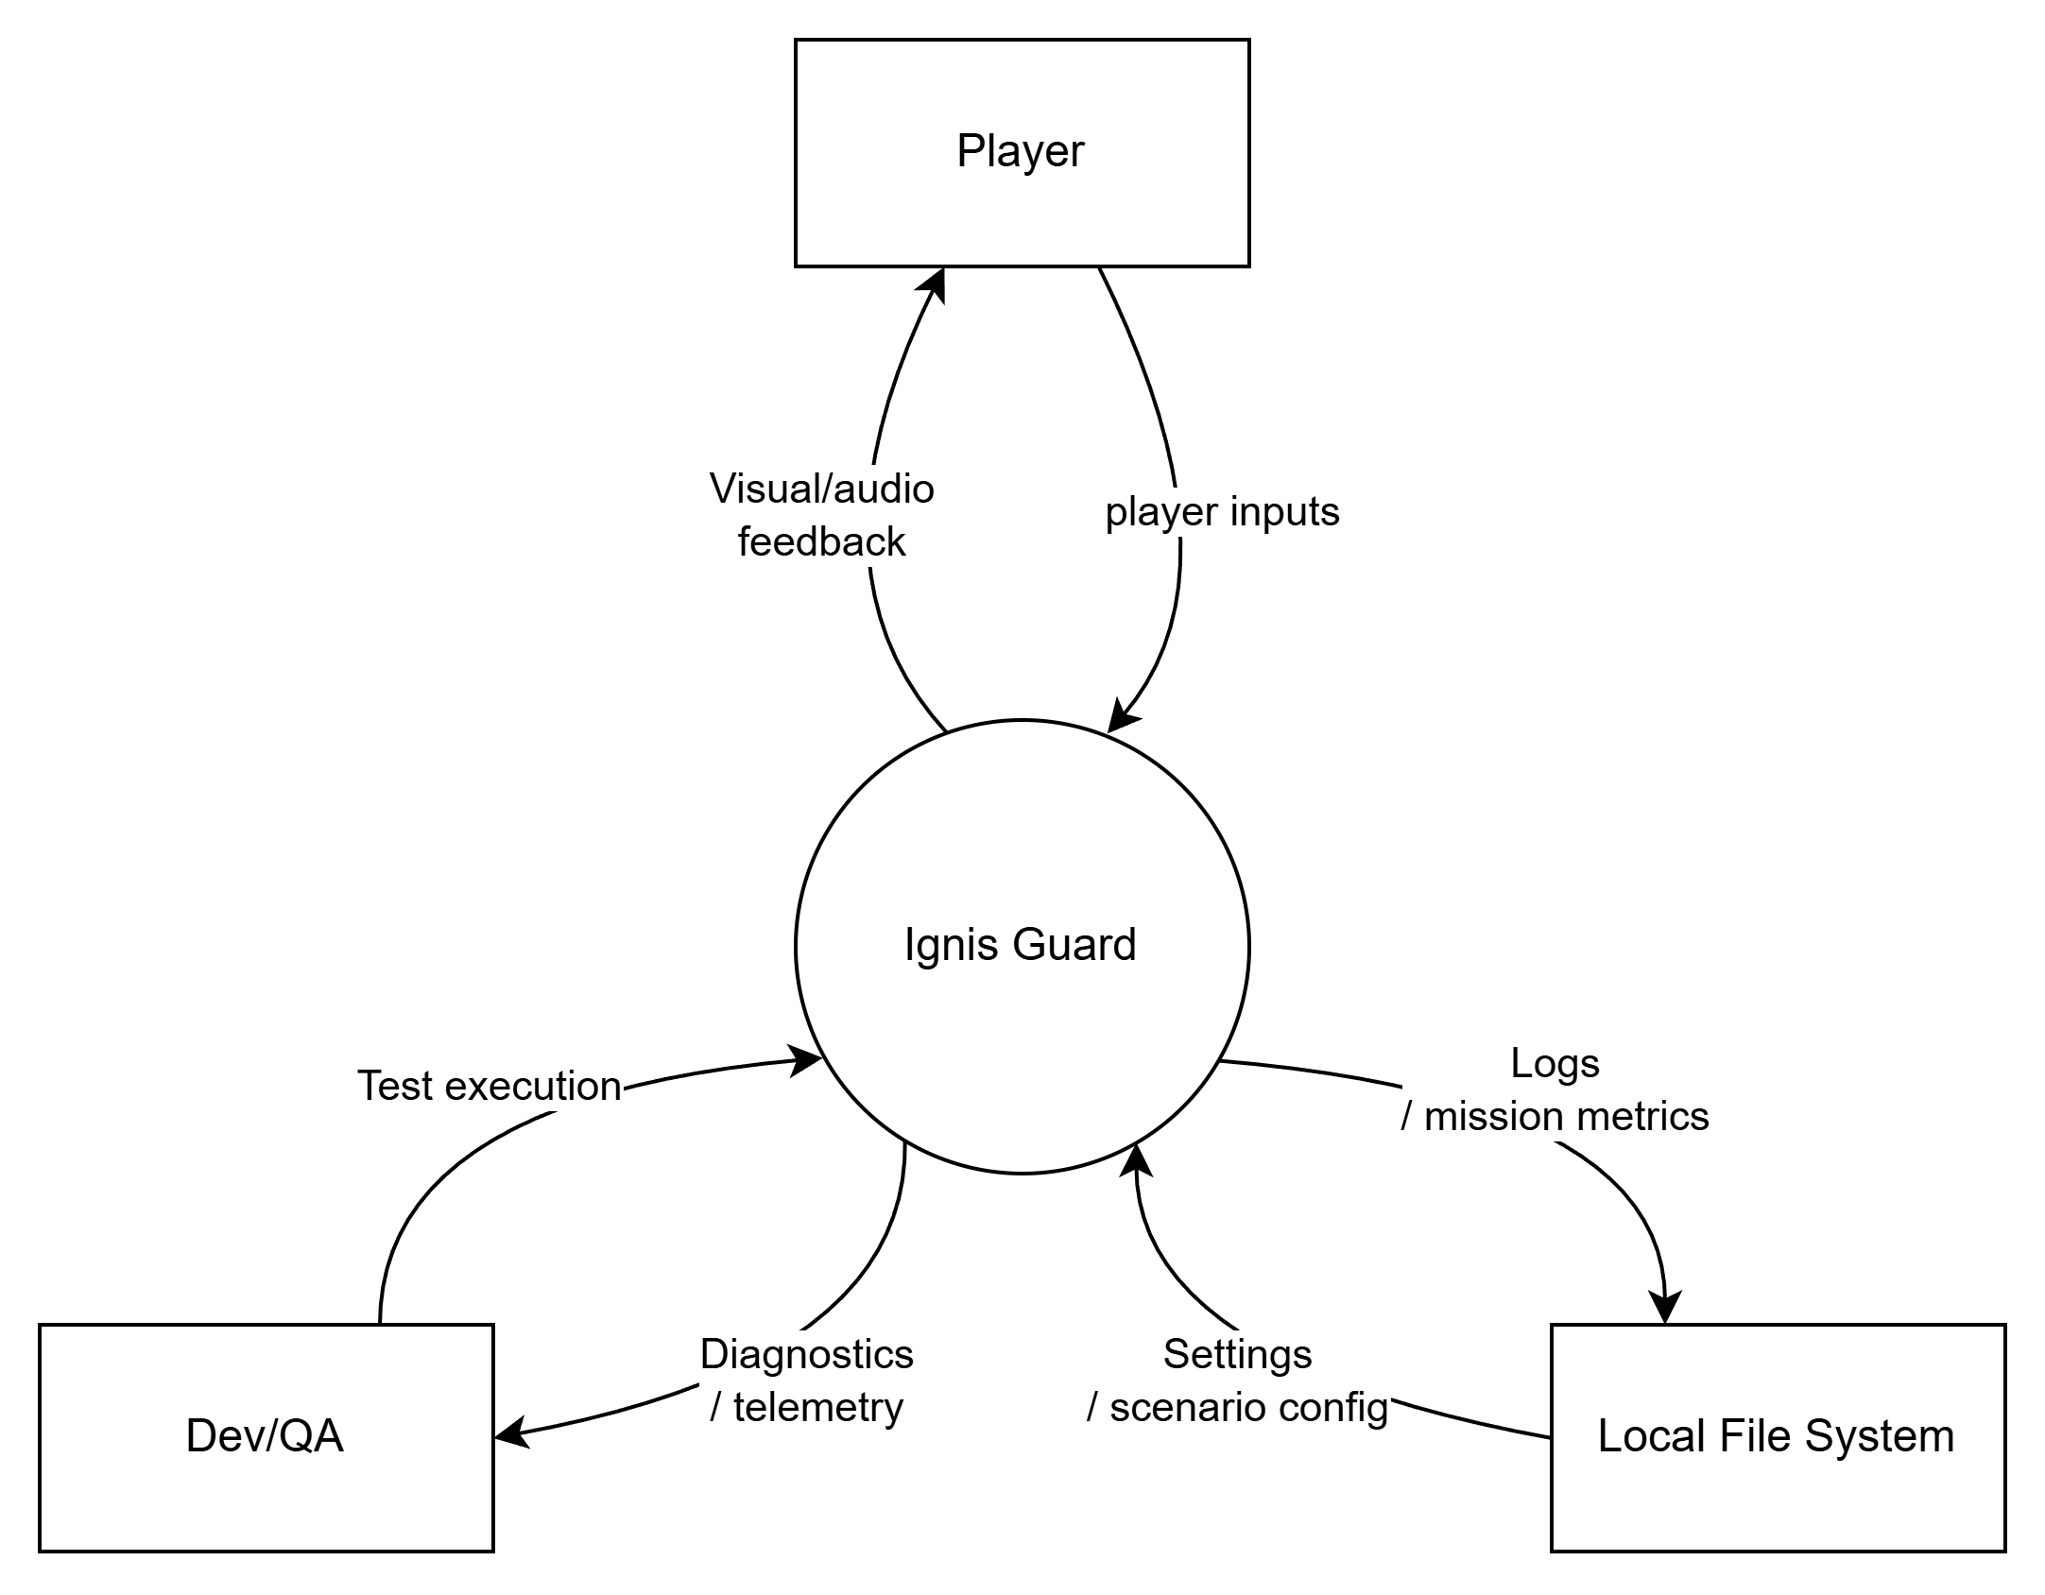
II. Requirements
2.1 Context Diagram

Slide 8
II. Requirements
2.2 Key Requirements
Functional
Scenario selection
Call Phase with bounded questions
Incident State mapping
On-site interaction and mission execution
Bot commands
Debrief and local telemetry
Non-Functional
Average 60 FPS, minimum 30 FPS
Stability across repeated core-loop runs
Maintainability through data-driven configuration
Learnability for new players

Slide 9
II. Requirements
2.3 Business / User Flow
Player selects scenario
Player receives emergency call
System derives Incident State
System recommends loadout / briefing
Player executes mission on site
System generates score and debrief

Slide 10
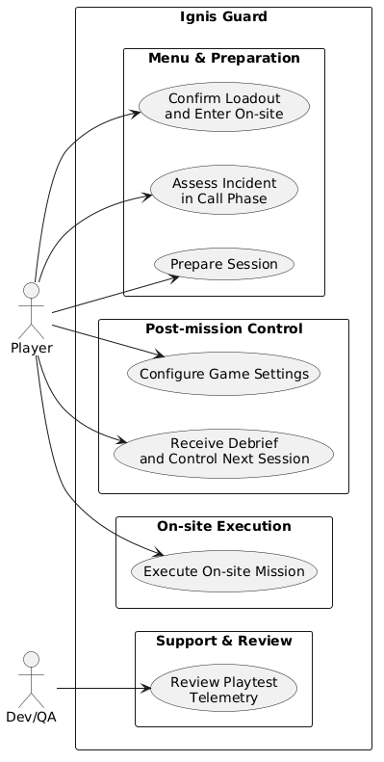
II. Requirements
2.4 UC diagram

Slide 11
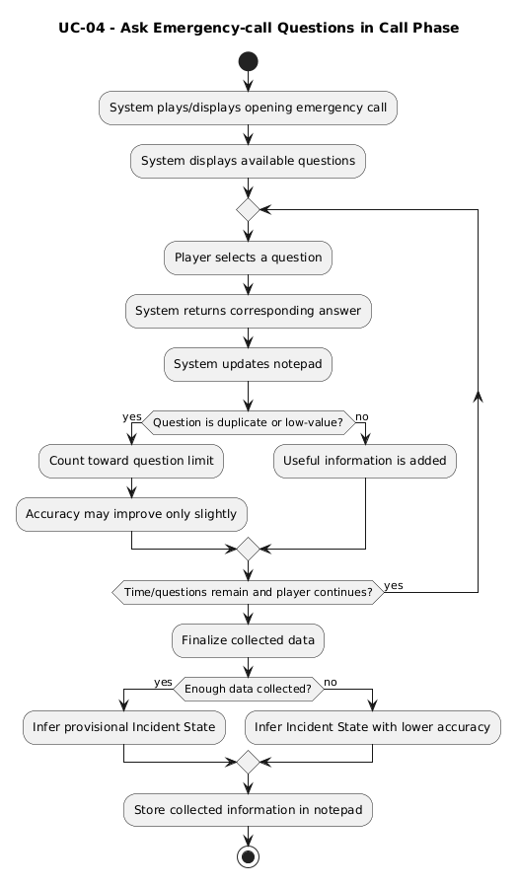
II. Requirements
2.5 Sample UC

Slide 12
III. Architecture
3.1 Software Architecture Overview
The project adopts a Modular State-Based Architecture combined with a Data-Driven Scenario Configuration approach.
A Finite State Machine (FSM) controls the major runtime states of the game.
The system supports two scenarios on one shared core architecture.
Scenario-specific differences are represented mainly through configuration data, scene content, hazard settings, and mission rules, instead of separate codebases.
This architecture is designed to improve predictability, reusability, and maintainability.

Slide 13
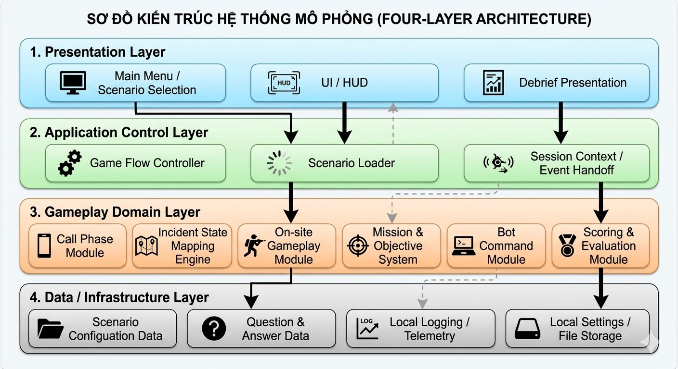
III. Architecture
3.2 Logical Architecture and Main Modules

Slide 14
IV. Process
Development Process and Timeline
Agile Scrum with milestone-based quality gates
10 sprints × 2 weeks
Major phases:
Planning
Analysis and scenario design
Architecture and implementation
Integration, QA, and balancing
Evaluation and finalization

Slide 15
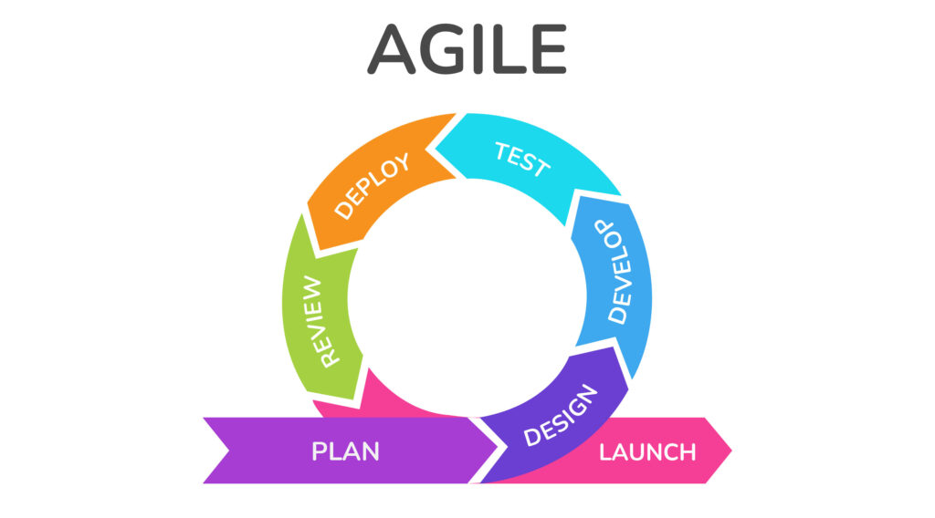
IV. Process
Development Process and Timeline

Slide 16
IV. Process
Development Process and Timeline
Week 1-4
Week 5-12
Week 13-16
Week 17-20
Baseline Approval & Scenario Analysis
MVP Implementation & Scenario 1 Integration
Scenario 2 Completion & Alpha/Beta Testing
Evaluation, Balancing & Final Packaging
Success Metric: Core loop stability and cause-effect transparency in the Debrief module.

Slide 17
V. Quality
Quality Assurance and Validation
QA, QC, and Quality Improvement activities
Unit-like logic tests for Incident State and scoring
Integration testing for Call → Scene → Debrief flow
Playmode/system tests for both scenarios
User evaluation for usability and learning effectiveness
Key metrics:
Performance
Stability
deterministic mapping
debrief effectiveness

Slide 18
VI. Conclusion
Ignis Guard addresses a real gap in firefighting training.
The project combines educational goals with a practical and reusable software architecture.
The two-scenario design demonstrates both MVP feasibility and architectural scalability.
The final goal is not only a playable game, but a meaningful training tool for structured decision-making and reflection.

